Slide 1
Capacitive MEMS Mirror
Deniz Karadayı
Mirza M. Karlidag

Slide 2
Introduction
Theory and Working Principle
Pull-in Effect
Fabrication
Design Concept and Specifications
Simulation Results
Conclusion

Slide 3
Introduction
What is the purpose of the device?
What is Capacitive MEMS Mirror Actuator?
What is Michelsen Interferometer?

Slide 4
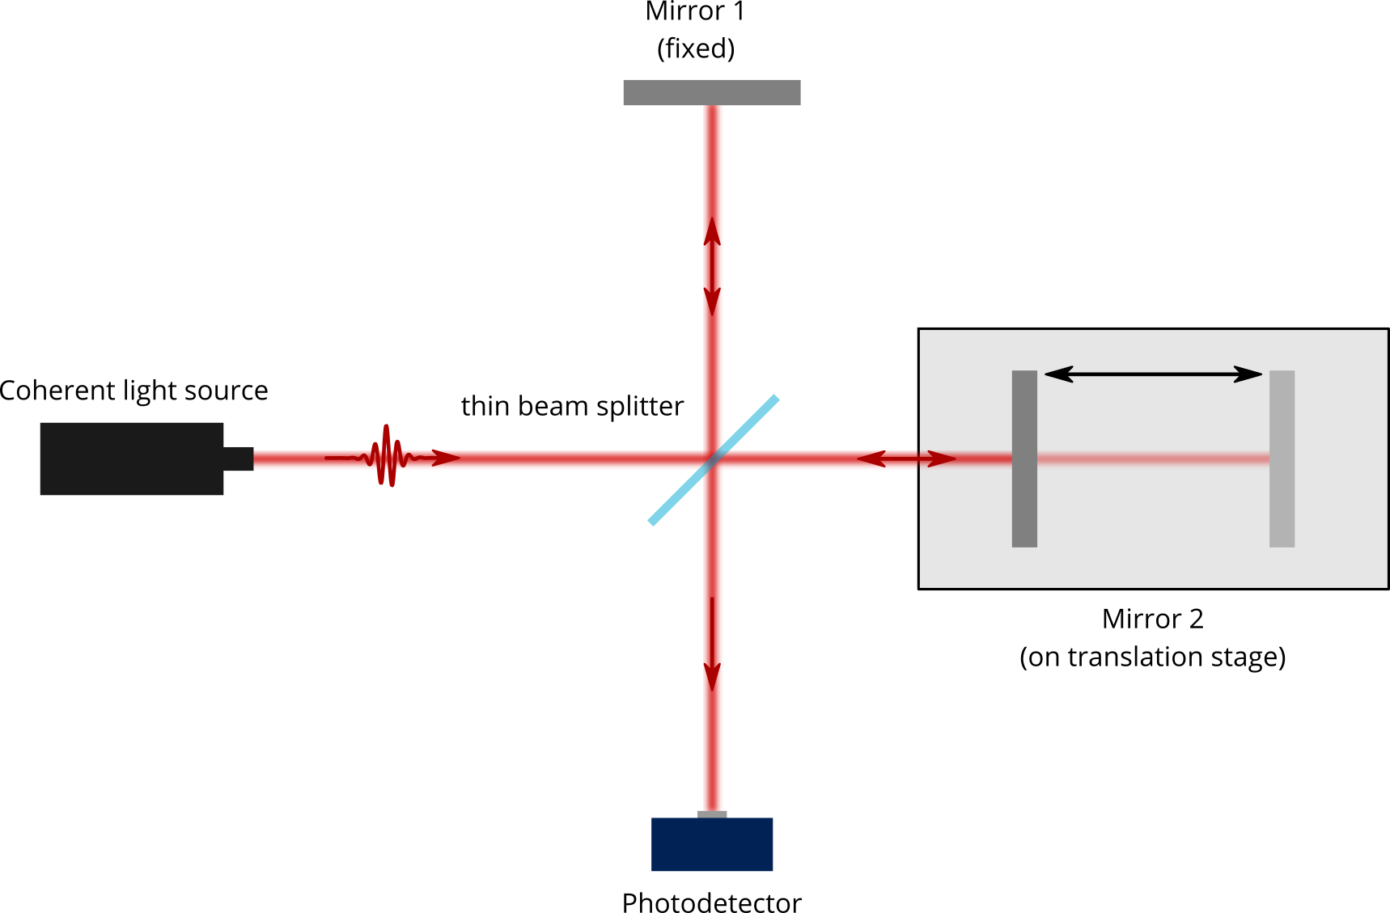
Michelson Interferometer
Fig. 2 - Interference Pattern [2]
Fig. 1 - Michelson Interferometer [1]

Slide 5
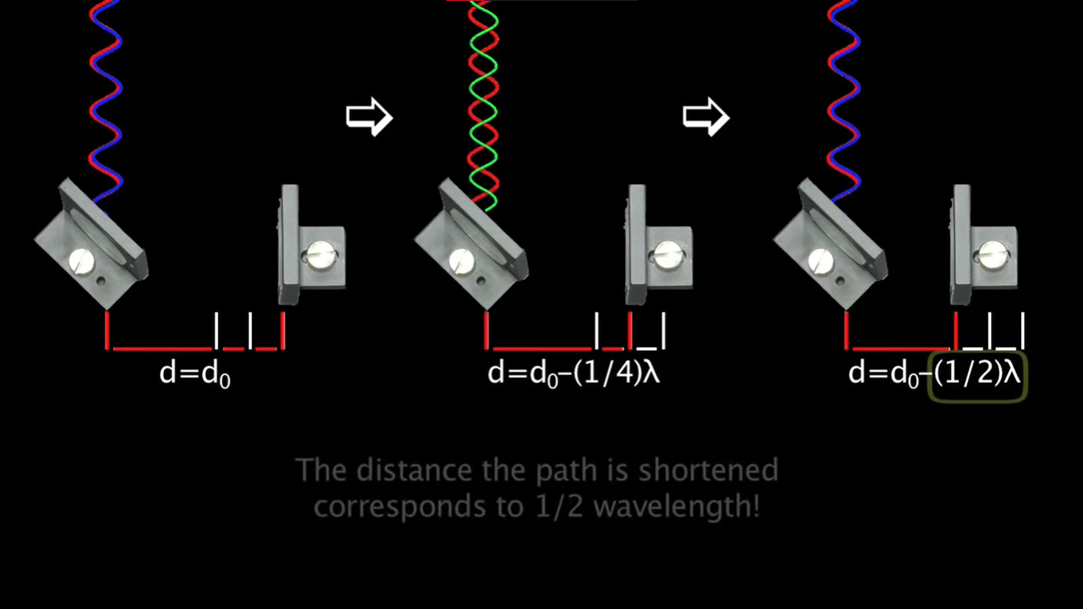
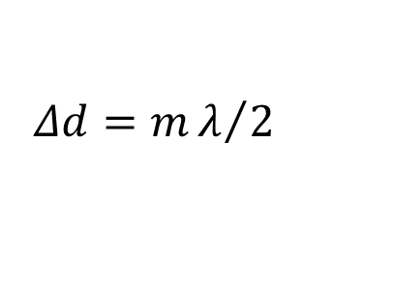
$$Δd=mλ/2$$
Fig. 3 – Effect of Movable Mirror on the Interference [3]

Slide 6
Theory and Working Principle

Slide 7
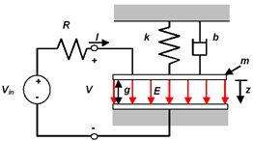
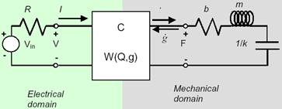

Slide 8
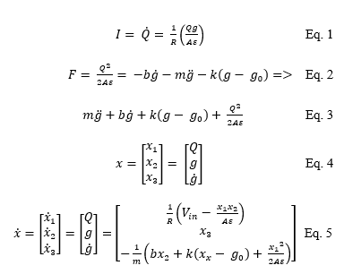

Slide 9
Pull-in Effect

Slide 10
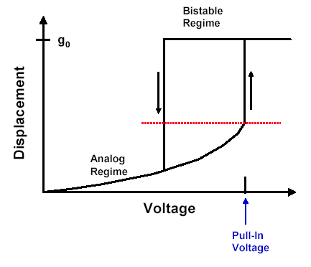
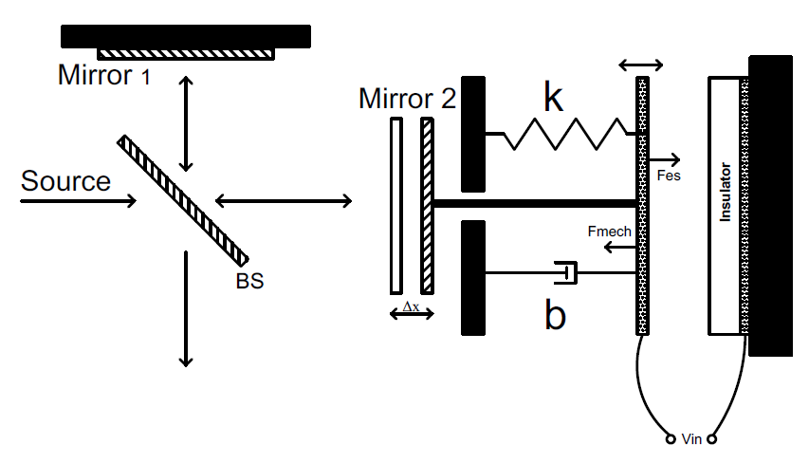

Slide 11
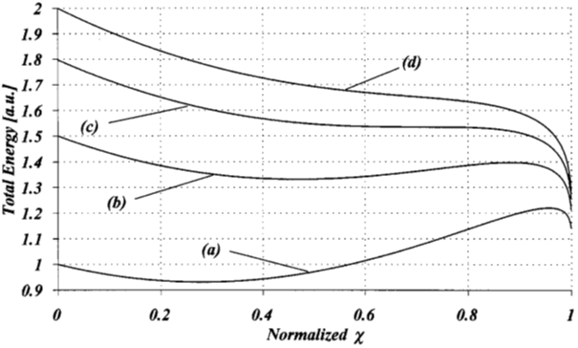
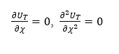

Slide 12
Fabrication

Slide 13
Deposition
Patterning
Masking
Etching
Coating

Slide 14
Design Concept and Specifications

Slide 15
Concept of Design

Slide 16
Simulation Results

Slide 17
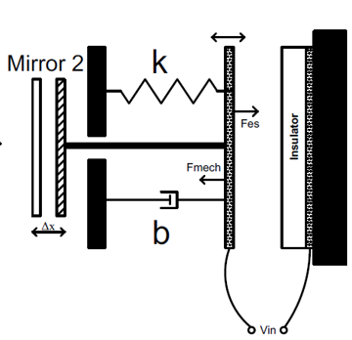
Design Specifications
Design Parameters |  | Dependent Parameters
initial gap | 300 µm | mass of plate | 582.5 ng
minimum gap | 60 µm | mass of mirror | 27 ng
width of plate | 50 mm | damping coefficient (α) | 785.40
length of plate | 50 m | spring coefficient (k) | 0.241 N/m²
thickness of plate | 0.1 µm | damper coefficient (b) | 9.57 * 10⁻⁴
resonant frequency | 100 Hz | natural resonant frequency (w0) | 628.32 rad/s
Q factor | 0.4
density of plate (Si) | 2330 g/m³
width of mirror | 1 mm
length of mirror | 1 mm
thickness of mirror | 0.1 µm
density of mirror (Al) | 2700 g/m³

Slide 18
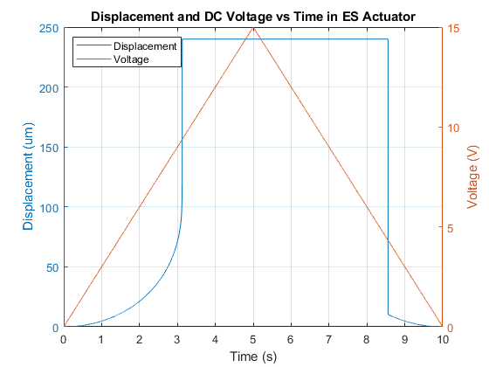
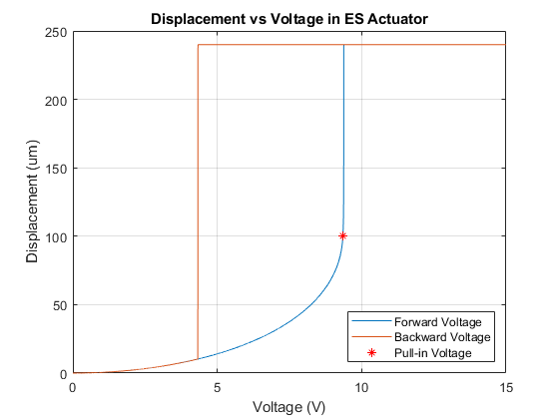
Displacement vs Voltage for DC Case
Pull-in Voltage (Vpi) | 9.34 V
Pull-in Displacement (Xpi) | 99.89 µm

Slide 19
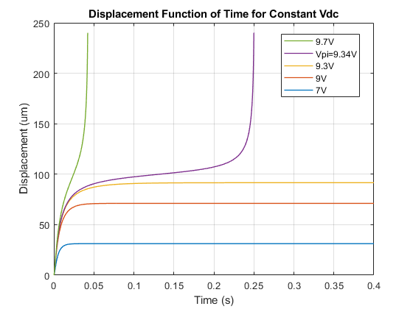
Time Response of the System for Constant DC

Slide 20
Deciding Design Parameters
Changed Parameter | Vpi (V) | Xpi (um)
0.5m(3.0475e-07) | 6.6100 | 98.3646
1.3m(7.9235e-07) | 10.6600 | 100.8466
2m (1.2190e-06) | 13.2200 | 101.8200
Q = 0.5 (Q*1.25) | 9.3410 | 97.6247
Q = 1 (Q*2.5) | 9.3300 | 95.2003
Q = 5 (Q*12.5) | 8.8920 | 66.9341
f0 = 80 Hz | 7.4880 | 103.0388
f0= 120 Hz | 11.2100 | 98.5116

Slide 21
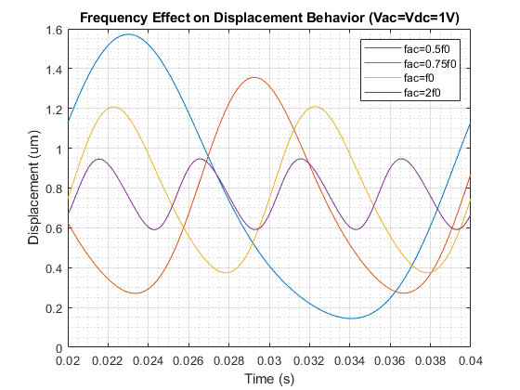
Effects of AC Voltage Usage: AC frequency
Frequency | Center of Oscillation | Gain of Oscillation
50 Hz (0.5 f_{res}) | 0.7706 | 0.8033
75 Hz (0.75 f_{res}) | 0.7695 | 0.5872
100 Hz (1 f_{res}) | 0.7737 | 0.4361
200 Hz (2 f_{res}) | 0.7731 | 0.1741

Slide 22
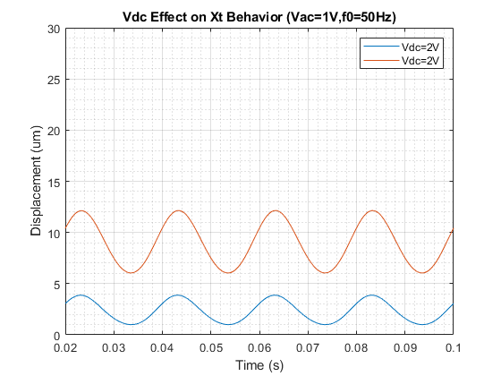
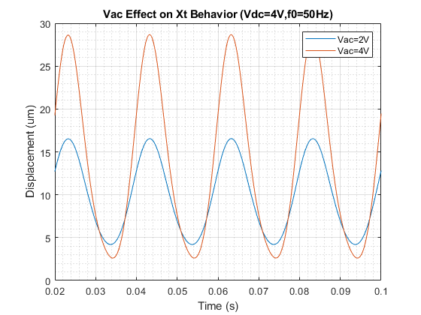
Effects AC and DC Voltage Components
Vac | Vdc | Center of Oscillation (um) | Gain of Oscillation (um)
1 V | 2 V | 2.3342 | 1.5373
1 V | 4 V | 8.9455 | 3.1964
Vac | Vdc | Center of Oscillation (um) | Gain of Oscillation (um)
2 V | 1 V | 9.8552 | 6.6878
4 V | 1 V | 13.9382 | 27.9018

Slide 23
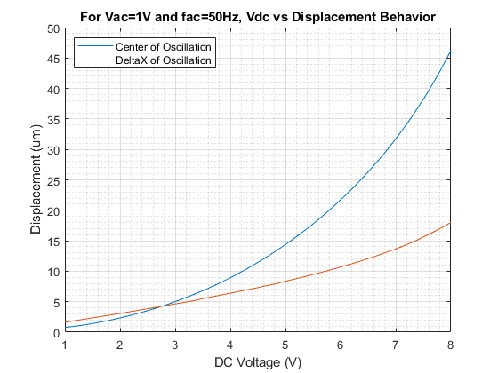
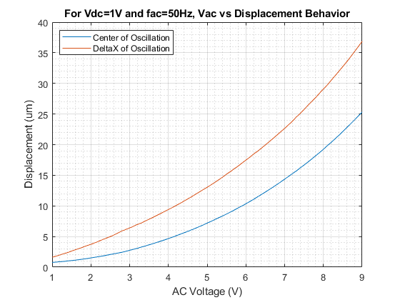
Effects AC and DC Voltage Components

Slide 24
Conclusion
For our design: Voltage Controlled Single Paralel Plate Actuator
- Xpi > 0.5 g0 is not achievable.
- Best Case Xpi = 1/3 g0
Nearly 100 um displacement by use of V~Vpi can be achievable
Light with wavelength up to 200 um can be measured with this design

Slide 25
Conclusion
DC Voltage
By use of graph, x can be laced from 0 to 100 um displacement
AC Voltage
By adjusting deltaX and center of oscillation, wanted displacement in a given point can be supplied
AC -> Gain of Oscillation
DC -> Center of Oscillation

Slide 26
References:
[1] "The Michelson Interferometer - A Laser Lab Alignment Guide", WiredSense, 2021. [Online]. Available: https://www.wiredsense.com/tutorials/the-michelson-interferometer-a-laser-lab-alignment-guide. [Accessed: 17- Jan- 2021].
[2] Source: Youtube: Michelson Interferometer GIF [Online]. Available: https://gfycat.com/flatdemandingatlanticridleyturtle. [Accessed: 17- Jan- 2021].
[3] The Technical Services Group of MIT's Department of Physics. “Michelson Interferometer”, YouTube, 22 June 2012. [Video file]. Available: https://www.youtube.com/watch?v=j-u3IEgcTiQ. [Accessed: 17- Jan- 2021].

